Slide 1
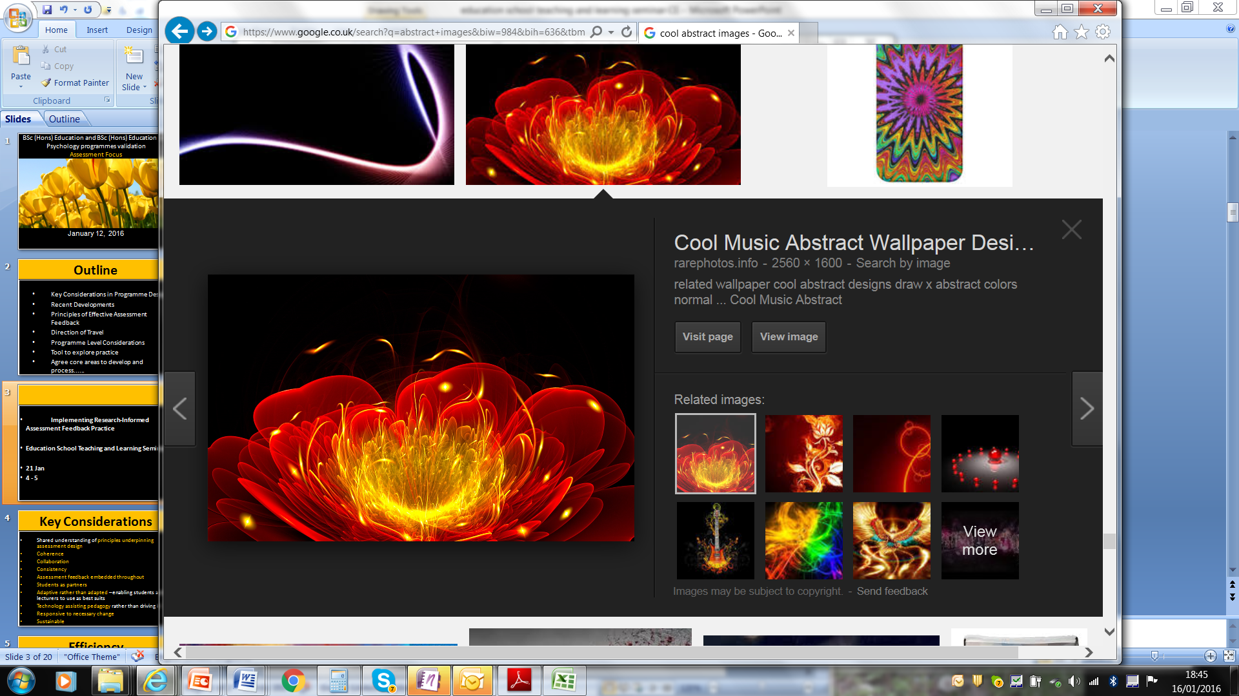
Researching Assessment Practices
RAP
Cool Music Abstract Wallpaper Designs - Rare photos rarephotos.info2560 × 1600
Politics June 3rd 2016

Slide 2
Overview
What do we know about key principles underpinning effective assessment feedback designs?
University priorities moving forward
Can (EAT) evaluation tool help to explore dimensions of assessment feedback practice
What can we do now?

Slide 3
Coherence
Consistency
Collaboration

Slide 4
Key Foci
Clarifying student entitlement
Making the requirements of assessment explicit
Reducing the burden of assessment
Focused feedback
Fitness for purpose of evaluation forms
Efficiency and effectiveness of marking and moderation processes and procedures

Slide 5
Priority 1: What is good?
AL1 Clarify what constitutes good so students know what they need to do and how to get there
Provide opportunities for students to mark work using assessment criteria and so that they can see different versions of what constitutes good. Snippets of work to demonstrate key points can be valuable.

Slide 6
Priority 2: Entitlement
AL3 Make student entitlement clear.
Make it explicit from the outset what the student role in assessment and feedback is. Clarify how many hours of support they are entitled to and what form this will take.

Slide 7
Priority 3: Focused Feedback
AF1 Focused feedback
Streamline feedback to focus on: what was good; what let them down if anything; how can they improve. Explain the rationale behind what you are doing feedback.

Slide 8
Holistic Assessment Framework
EAT: 3 main areas:
Assessment Literacy
Assessment Feedback
Assessment Design

Slide 9
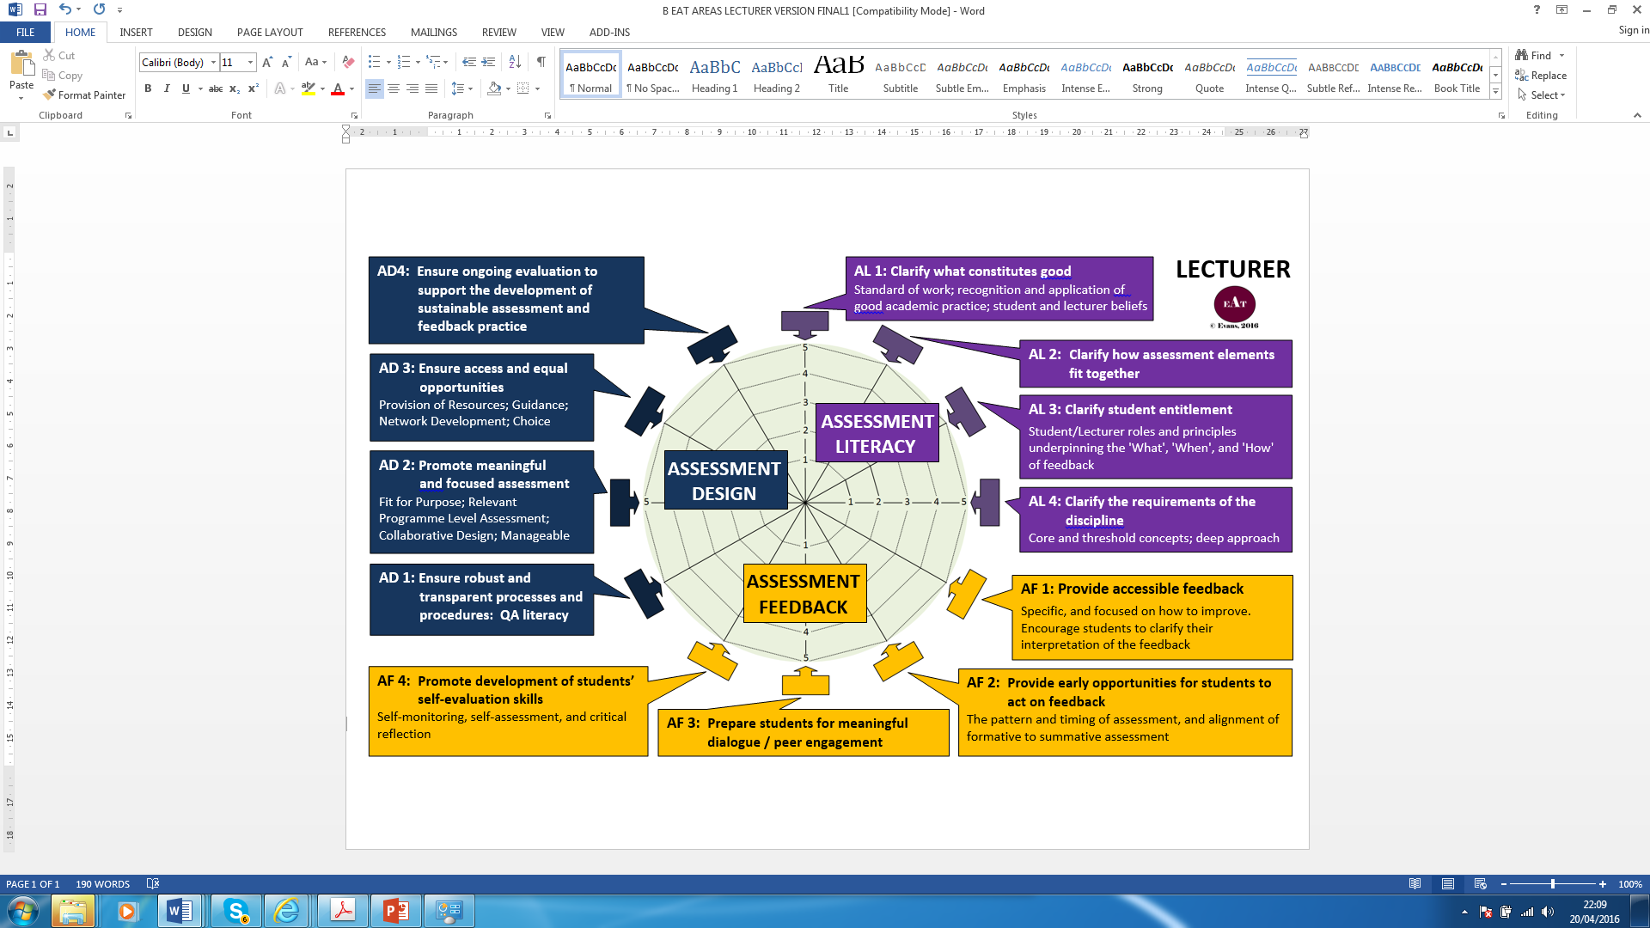

Slide 10
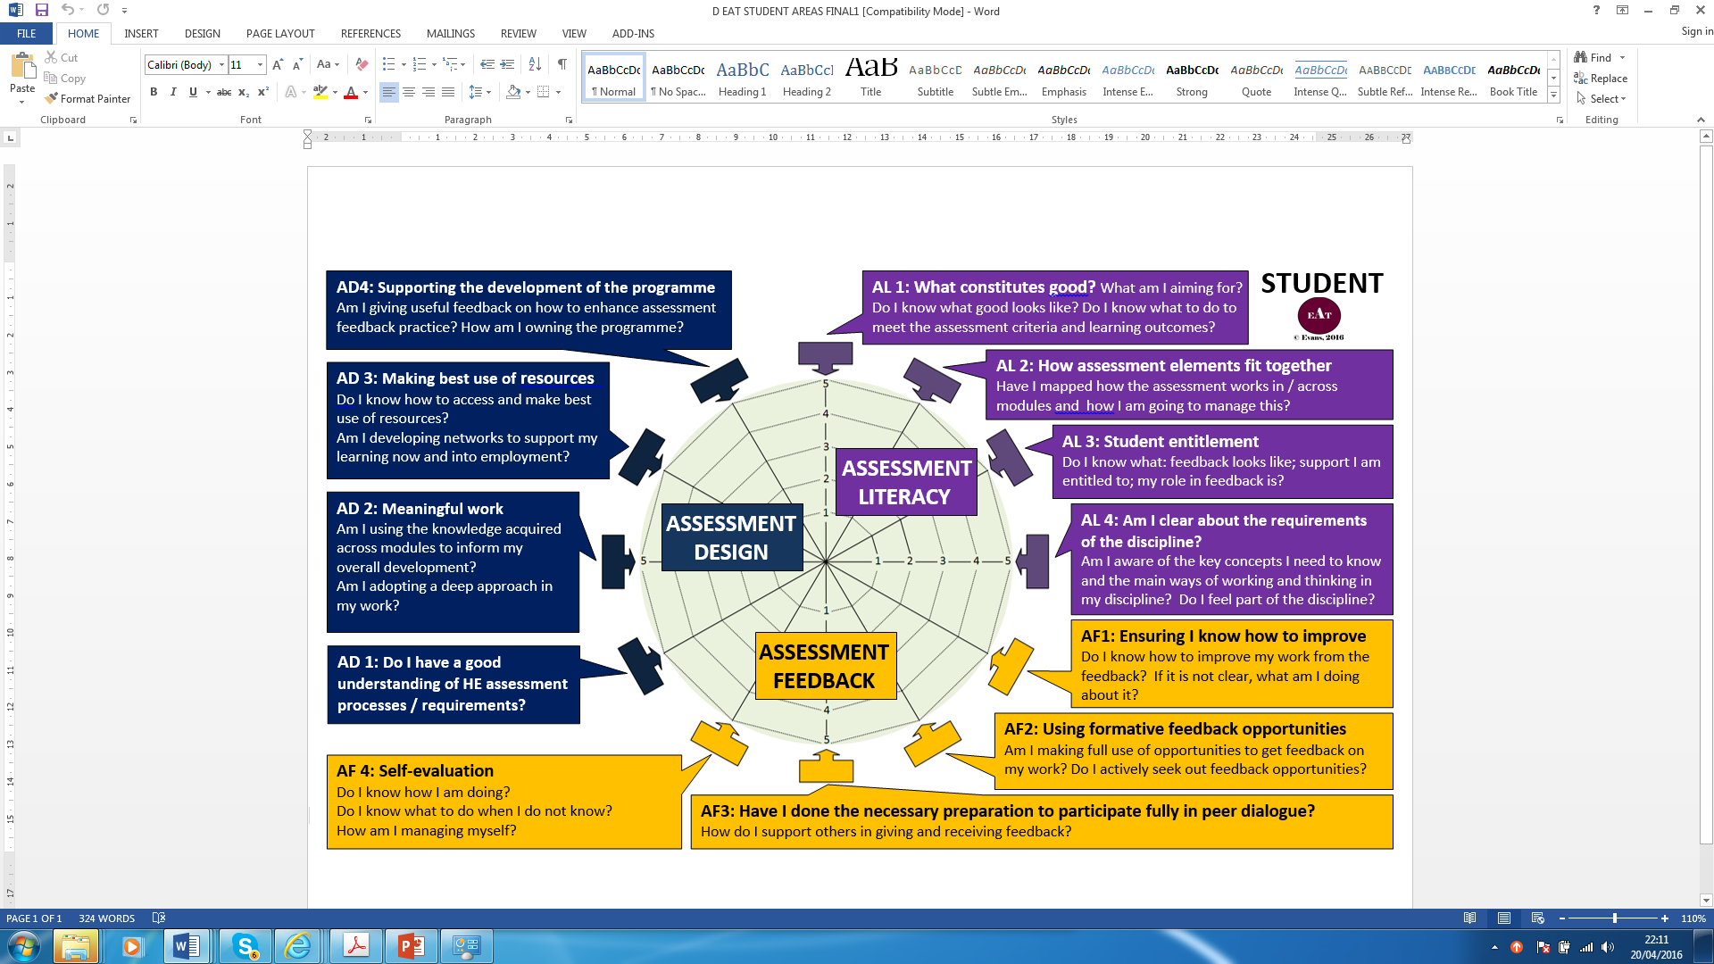

Slide 11
Discipline Representatives
Liaison between RAP & disciplines
Collate & share resources
Co-ordinating specific events
Co-ordinating assessment approach within discipline
Involved in research

Slide 12
Programme Level Assessment
Level 1: Ensuring Alignment of assessment across modules
How to enable Level 1: systems and processes to support this?
Process to review alignment at time of re-validation
Level 2: Assessing at programme and not necessarily the module level

Slide 13
Level 1
Agreeing what is meaningful and appropriate assessment
Rationalising learning outcomes & modules where appropriate
Ensuring coherence in how all modules fit together
Reviewing the nature of assessment tasks across modules and years to ensure a varied and appropriate diet
Considering how issues of choice / flexibility are being addressed.
  Reviewing timings of assessment
Reviewing the balance and alignment of formative and summative assessment

Slide 14
Changes in emphasis in NSS 2017
The degree to which students feel part of a learning community
Do students feel that their feedback is being used to enhance programme design?
Depth of learning; application, and synthesis to try and capture notions of deep approaches.

Slide 15
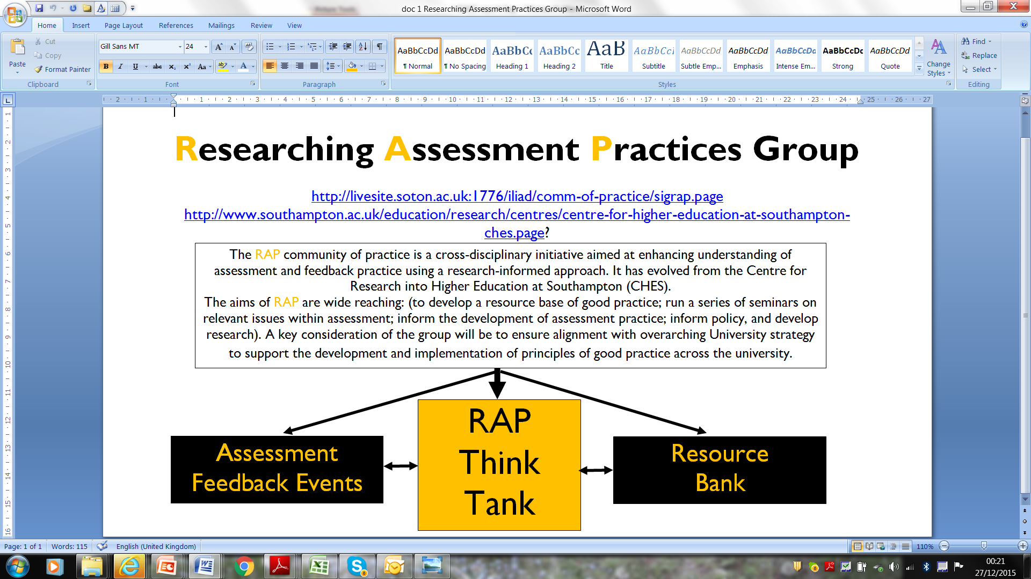
Bespoke training

